Slide 1

Predict the intention of an online shopper to make purchases on a website by analyzing their online behavior. -Using Machine Learning Methods

Slide 2
Project Objective
Train different models using below Machine Learning methods and compare their performances.
Binominal Logistic Regression (Lasso, Ridge)
Support Vector Machine
Linear
RBF
polynomial
Sigmoid

Slide 3

Agenda
Machine Learning in Retail Industry- Overview
Dataset Overview & Characteristic
Methods and Tools
Results and Comparison
Summary & Pitfalls

Slide 4

Machine Learning in Retail Industry

Slide 5
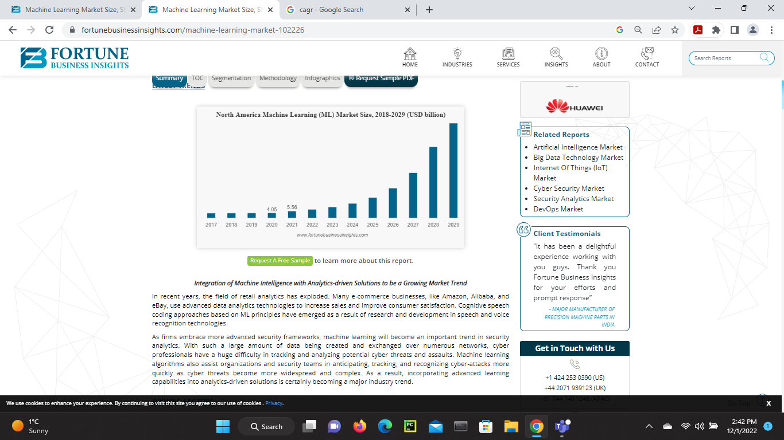
Fortune Business Insights
Source: https://www.fortunebusinessinsights.com/machine-learning-market-102226

Slide 6
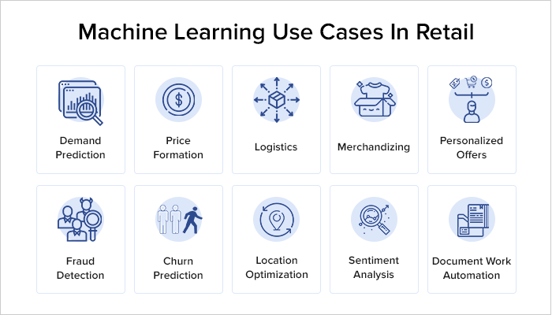
Image Source: https://www.mobileappdaily.com/how-ml-in-retail-impacting-businesses

Slide 7

Dataset Overview & Characteristics

Slide 8
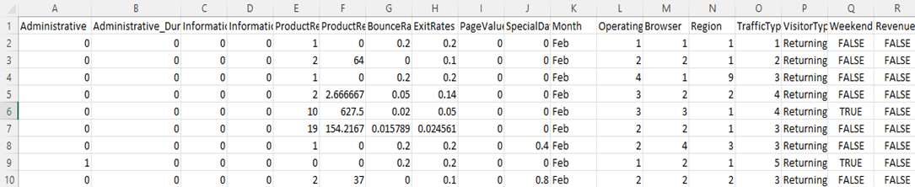
Dataset
Numerical
Categorical
Target
Data Source:
The dataset is from online site Kaggle:
Online Shoppers Intention UCI Machine Learning | Kaggle
(See detailed information in Appendix: Data Source segment)

Slide 9
Initial Dataset Exploration
Number of instances : 12330
Number of attributes: 18 (17 predictors, 1 Target)
Missing values: N/A
Outliers : Yes

Slide 10
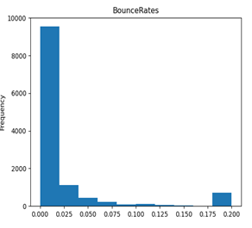
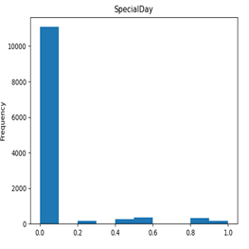
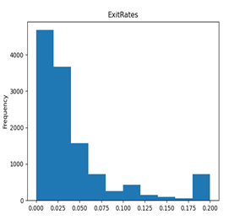
Data Challenges: Outliers

Slide 11
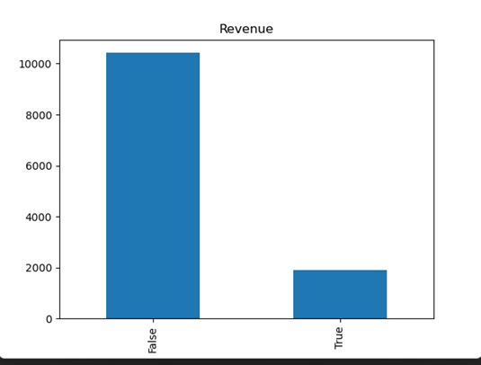
Data Challenges: Unbalanced Dataset
Target : Revenue
Boolean data indicating presence if there is a Revenue.
84.5% instances are for False

Slide 12

Methods & Tools

Slide 13
Methodology
Data Preparation
Data split (70:30)
Train Models
Predict Test data
Estimate & Compare models Performance

Slide 14
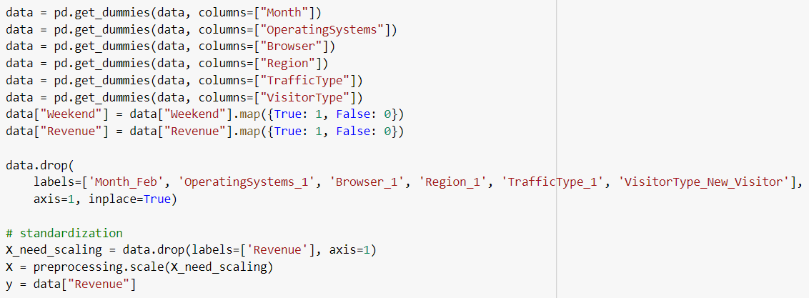

Data Preparation
Dummy Coding Categorical Variables
Standardizing Numerical Variables
After Standardization, we can see
Number of attributes: 69 (68 predictors, 1 Target)

Slide 15


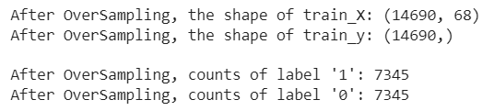
SMOTE: Over-Sampling Unbalanced Data
Data Split
0 - False
1 - True
Over Sampling training Data

Slide 16
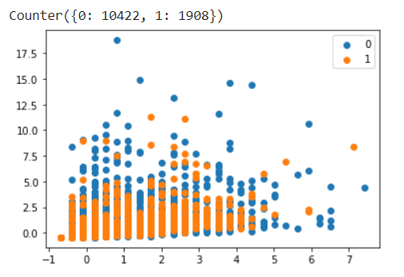
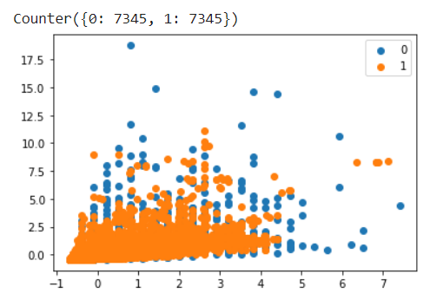
SMOTE: Over-Sampling Unbalanced Data
Before Over Sampling (Original Data)
After Over Sampling (Training Data)

Slide 17

Tools : Python
Method:
1) Binominal Logistic Regression
from sklearn.linear_model import LogisticRegression
clf = LogisticRegression()
2) Support Vector Machine w/o Cross-Validation
from sklearn import svm
clf = svm.SVC(kernel="linear", probability=True)
clf = svm.SVC(kernel="rbf", probability=True)
clf = svm.SVC(kernel="sigmoid", probability=True)

Slide 18

Results & Comparison

Slide 19
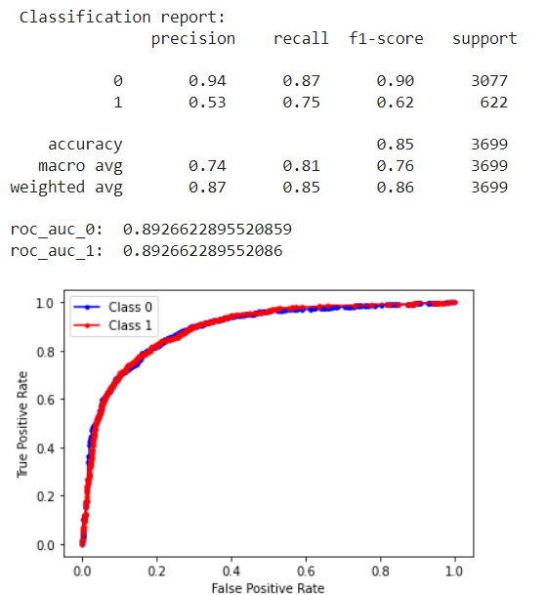
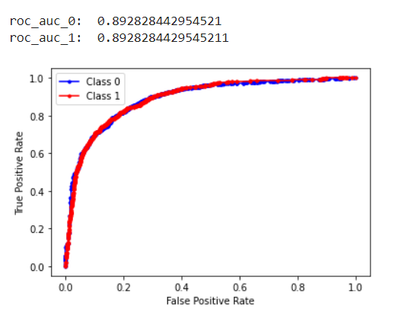
Binominal Logistic Regression
Lasso
Ridge

Slide 20
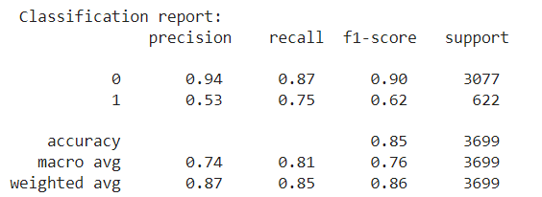

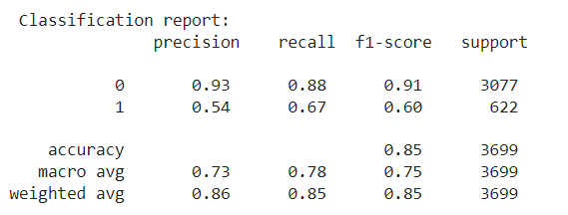
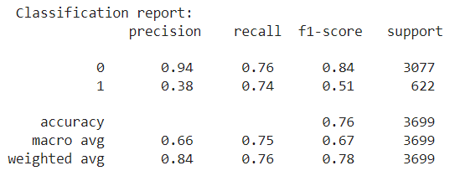
Performance
Best Performance without Cross Validation
Logistic Lasso Regression
SVM Linear w/o CV
SVM RBF w/o CV
SVM Sigmoid w/o CV
20

Slide 21
Different Models AUC (Without Cross Validation)
Logistic Lasso Regression Model AUC - 0.892662289552086
Logistic Ridge Regression Model AUC - 0.892828442954521
SVM Linear Model AUC - 0.9042480931545844
SVM RBF Model AUC - 0.8701385761175906
SVM Sigmoid Model AUC - 0.808348320230901
21

Slide 22
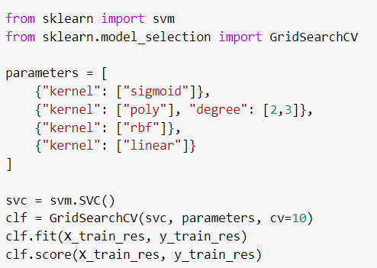
Support Vector Machine using CV
22

Slide 23
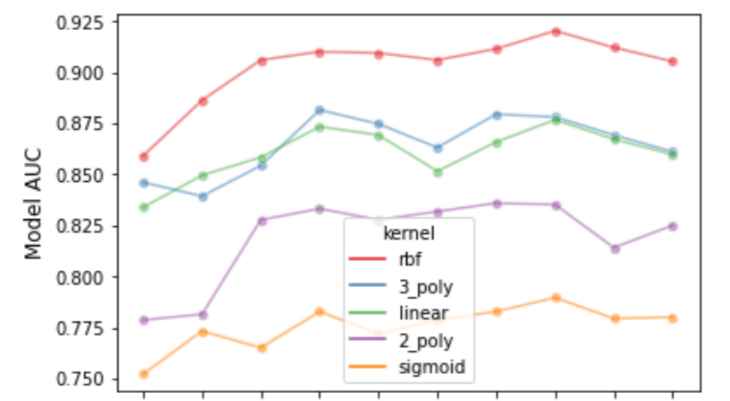
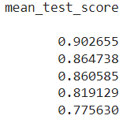

Support Vector Machine using Cross-Validation
After training the model using GridSearchCV, RBF Kernel yields the better performance.
1 2 3 4 5 6 7 8 9 10
CV test fold

Slide 24

Pitfalls & Summary
24

Slide 25
Pitfalls & Learning
There are a lot of zeros in the few columns of data, and the mean is less than 0.05, but we didn't eliminate them because there are only 68 columns.
We over-sampled the data since it was extremely unbalanced, and we did not use under-sampling because it would have reduced the original data (records).
Since our data set is unbalanced, we don't use accuracy of the confusion matrix. Using other metrics such as recall, precision, F-score and AUC will be better evaluator of the model performance.
Training model without using Cross Validation can give ambiguous results.

Slide 26
Summary
Because our dataset was imbalanced, we oversampled the data using SMOTE analysis before training our models.
The best model for this type of dataset is the Radial Basis Function (RBF) model, with an accuracy of 0.902655. This model is suitable for datasets that have multiple features and can accurately classify data points.
In general, when working with datasets that have multiple features, the RBF model is often the best choice. It is robust to changes in the data and can accurately classify data points. This makes it a great choice for datasets that have a high degree of variability.
Used different types of cross-validation techniques, such as GridSearchCV and RepeatedStratifiedKFold to improve and evaluate the performance of a model better.
Support Vector Machine (SVM) is known for its high tolerance for outliers, and the Radial Basis Function (RBF) kernel is often seen to provide the best performance.
RBF kernel can handle large datasets with high dimensionality, and it has a regularization parameter that allows it to avoid overfitting.

Slide 27
Thank You

